Slide 1
BSC1520: Statistics
Lecture 02:
Data Visualization and Data Spread

Slide 2
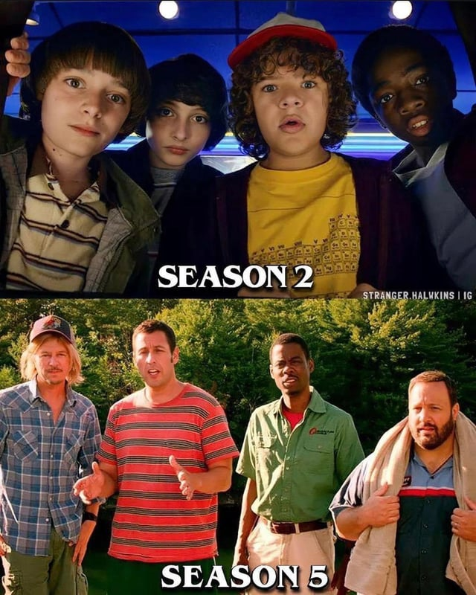
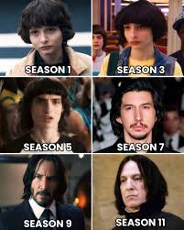
Stranger Things are (finally) over…
Notes:
IARC

Slide 3
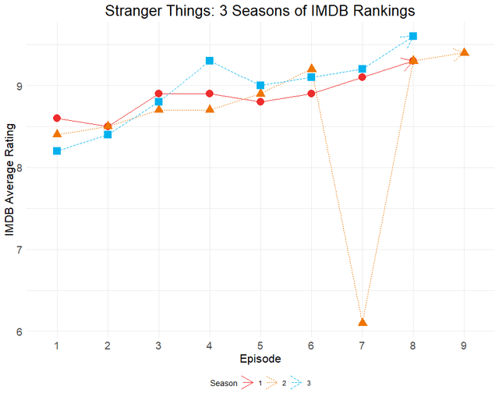
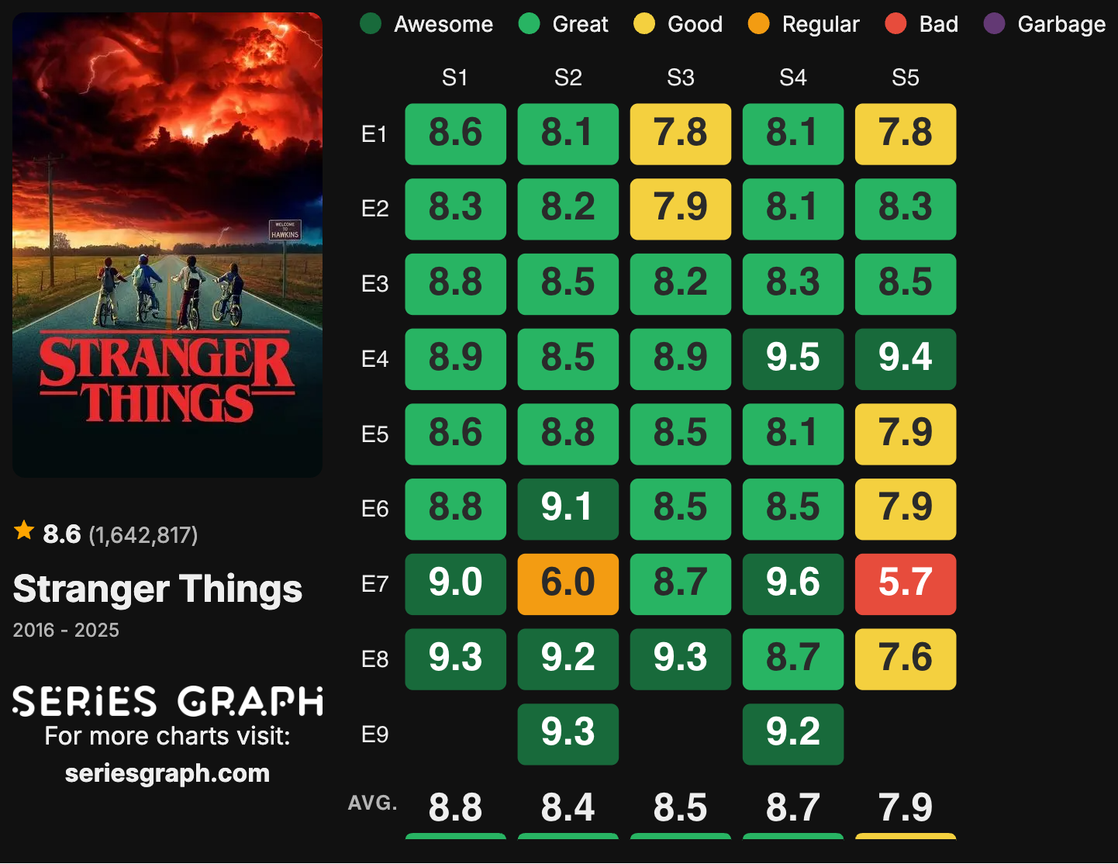
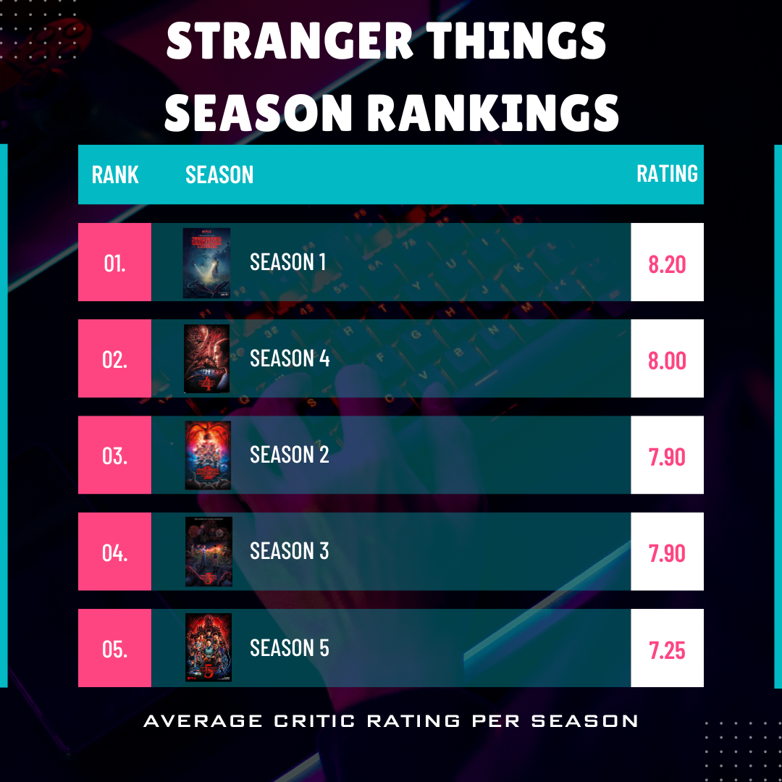
Stranger Things is over…
What visualization of the show’s ratings do you think is the best?
1
2
3
Notes:
IARC

Slide 4
Stranger Things is over…
What visualization of ratings do you think is the best?
1
2
3
Best for what?
What do we want/need to show?
Notes:
IARC

Slide 5
Stranger Things is over…
Is it a good show overall?
Do you think viewers left happy with the ending?
What are the trends per episode?
Notes:
IARC

Slide 6
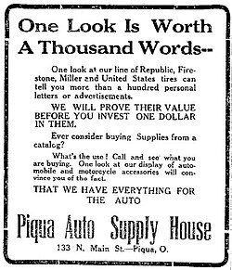
But why data visualization?
Data visualization can turn raw data into insight, and insight into impact:
Data alone is not insight, aggregated and visualized data can provide insights
Visualization can reveal structure in data
Visualization can support better decisions
Notes:
IARC

Slide 7
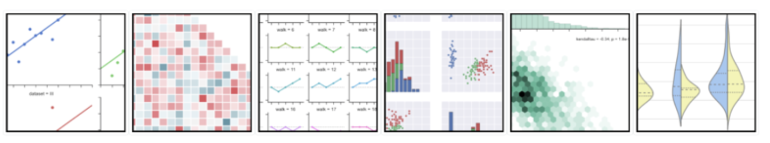
Visualization of Data
Convey information through graphical or tabular representations of data.

Slide 8
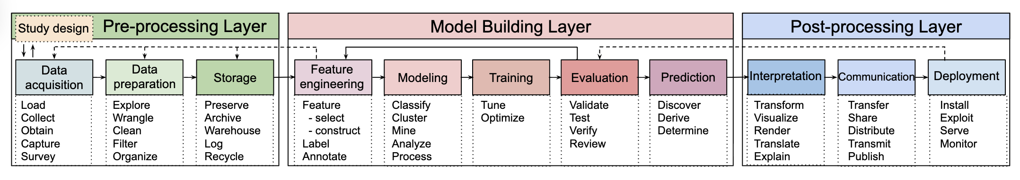
Visualization in Data Science Pipelines
You will have to use data visualization tools in the following roles:
Data Analyst, Data Scientist, Machine Learning Engineer, MLOps
Academic researcher
Managerial roles
Biswas, S., Wardat, M., & Rajan, H. (2022, May). The art and practice of data science pipelines: A comprehensive study of data science pipelines in theory, in-the-small, and in-the-large. In Proceedings of the 44th International Conference on Software Engineering (pp. 2091-2103).

Slide 9
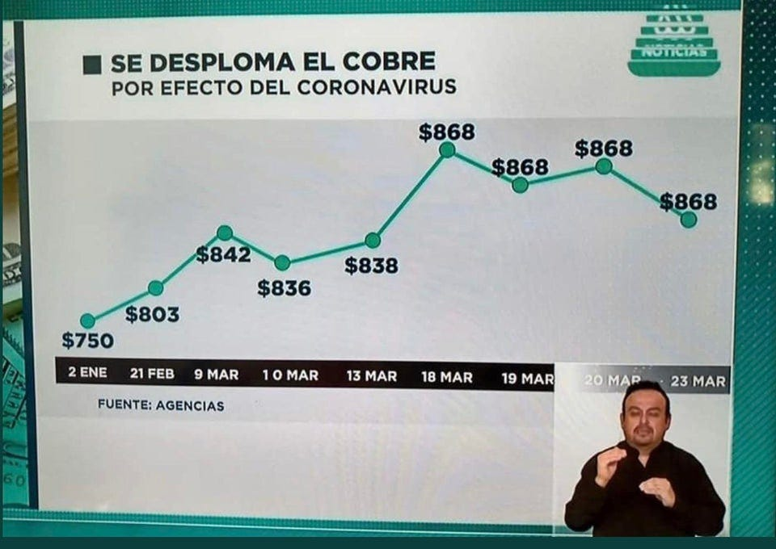
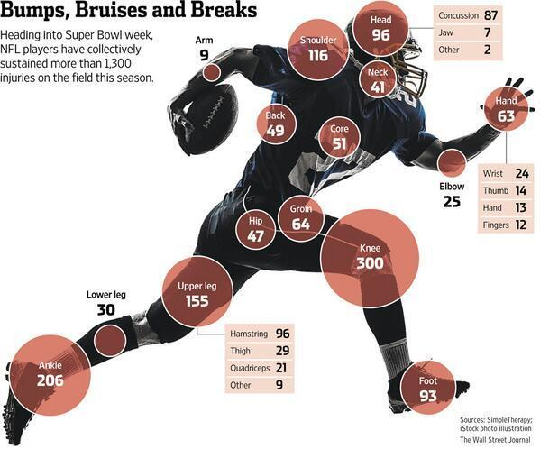
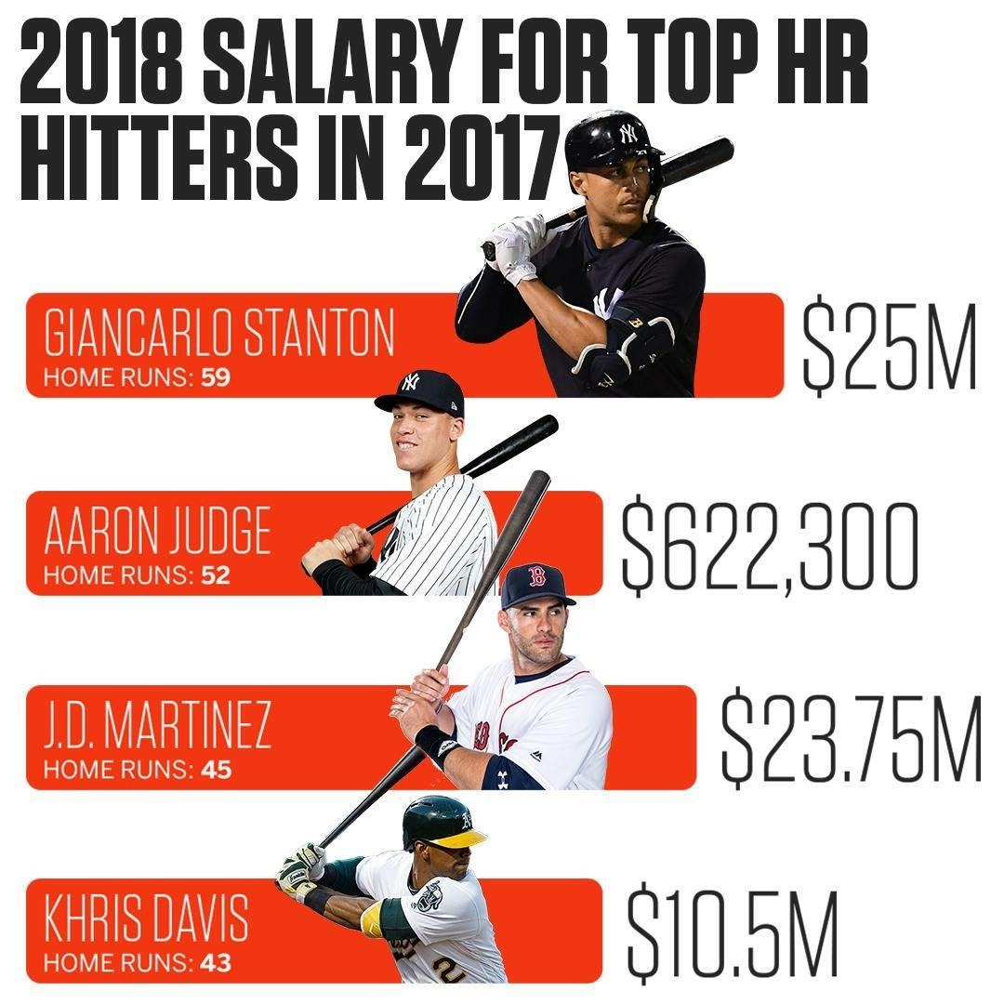
Good vs Bad communication:
https://thumbsupviz.tumblr.com/
https://viz.wtf/archive
Notes:
Why is this good communication? Clear presentation
Explains what its trying to say quickly
Gives evidence
Quickly able to unituit what is the area getting the most damage.

Slide 10
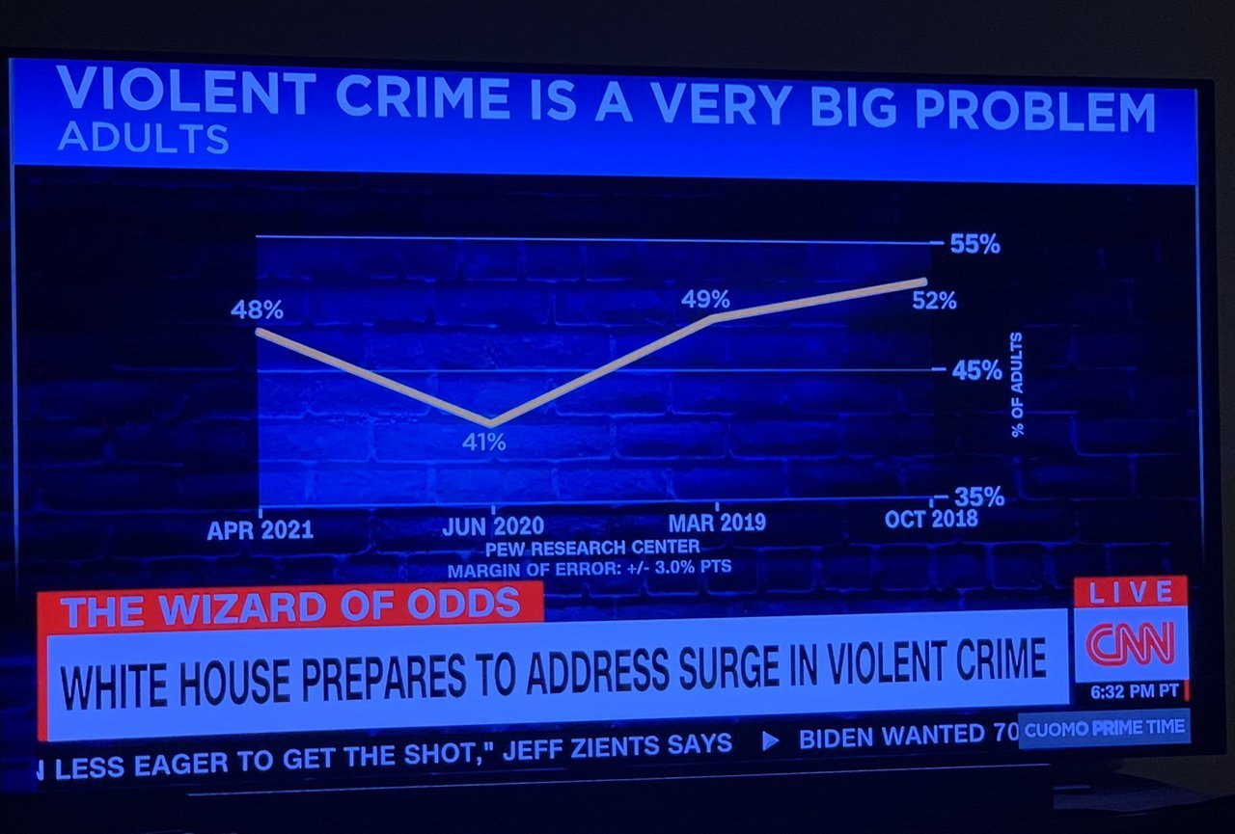
Good or Bad?
Look at the X-axis: quite misleading

Slide 11
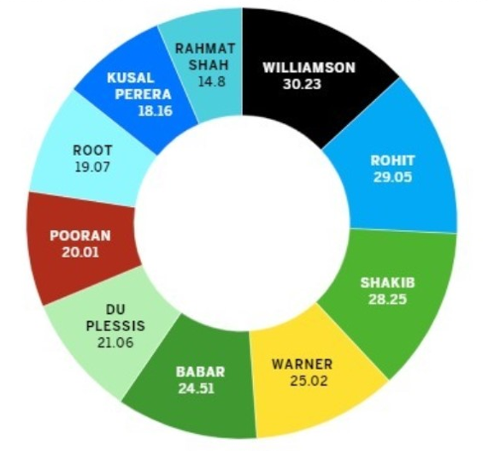
Good or Bad?
Can you visually compare different groups?

Slide 12
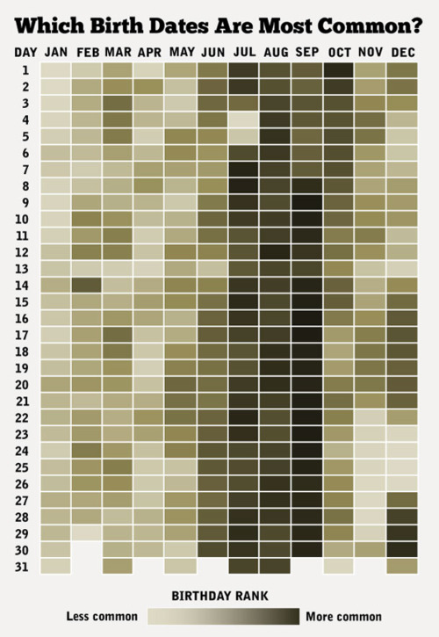
Good or Bad?

Slide 13
Numerical and categorical variables
In data science, we often manipulate various variables (numbers, categories, datetime, etc.).
Often, we try to transform them to numerical and/or categorical variables for further analysis
Variables
Numerical
Categorical
Continuous
Discrete
Ordinal
Nominal

Slide 14
Numerical and categorical variables
In data science, we often manipulate various variables (numbers, categories, datetime, etc.).
Often, we abstract them into numerical and/or categorical variables for further analysis
Variables
Numerical
Categorical
Continuous
Discrete
Ordinal
Nominal
Measured: typically, real values
Height, weight, time interval, temperature, etc.

Slide 15
Numerical and categorical variables
In data science, we often manipulate various variables (numbers, categories, datetime, etc.).
Often, we try to transform them to numerical and/or categorical variables for further analysis
Variables
Numerical
Categorical
Continuous
Discrete
Ordinal
Nominal
Counted: integer values
Number of users, number of clicks, items in cart, etc.

Slide 16
Numerical and categorical variables
In data science, we often manipulate various variables (numbers, categories, datetime, etc.).
Often, we try to transform them to numerical and/or categorical variables for further analysis
Variables
Numerical
Categorical
Continuous
Discrete
Ordinal
Nominal
Ranked: order matters, distances do not
Examples:
Education level (high-school, college, bachelors, etc.)
User satisfaction (low, medium, high)
Star ratings (1-5)

Slide 17
Numerical and categorical variables
In data science, we often manipulate various variables (numbers, categories, datetime, etc.).
Often, we try to transform them to numerical and/or categorical variables for further analysis
Variables
Numerical
Categorical
Continuous
Discrete
Ordinal
Nominal
No order, distinct categories
Examples:
Color (red, blue)
Continent

Slide 18
Numerical and categorical variables
In Data Science, we often treat numerical and categorical features using different techniques:
Same applies to data visualization
For the future: we often transform numerical features to categorical and vice versa!
Variables
Numerical
Categorical
Continuous
Discrete
Ordinal
Nominal

Slide 19
Guess the variable type
Length of video
“Rate this order from 1 to 5”
Number of likes under the reels
Type of account: ”business”, “personal”
Pain level (while solving derivatives): “None”, “Mild”, “Moderate”, “Severe”
Variables
Numerical
Categorical
Continuous
Discrete
Ordinal
Nominal

Slide 20
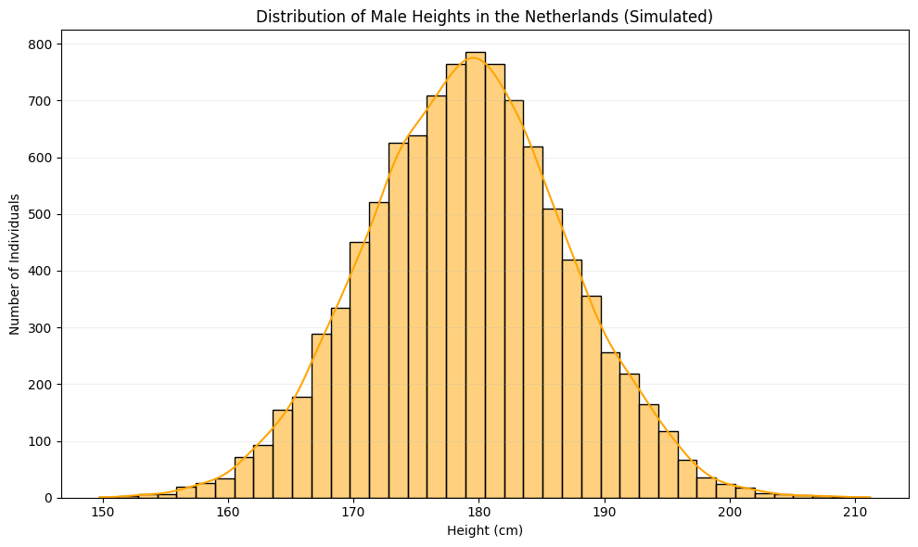
Visualizing numerical data
Definition
Distribution refers to the spread of the data over a number line. This in effect can be approximated with a mathematical structure – a probability distribution function, one that we will try to characterize with various tools.
“Symmetric” distribution

Slide 21
Visualizing numerical data
How to visualize distributions:
Bar plot
Boxplot
Violinplot
Stripchart
…

Slide 22
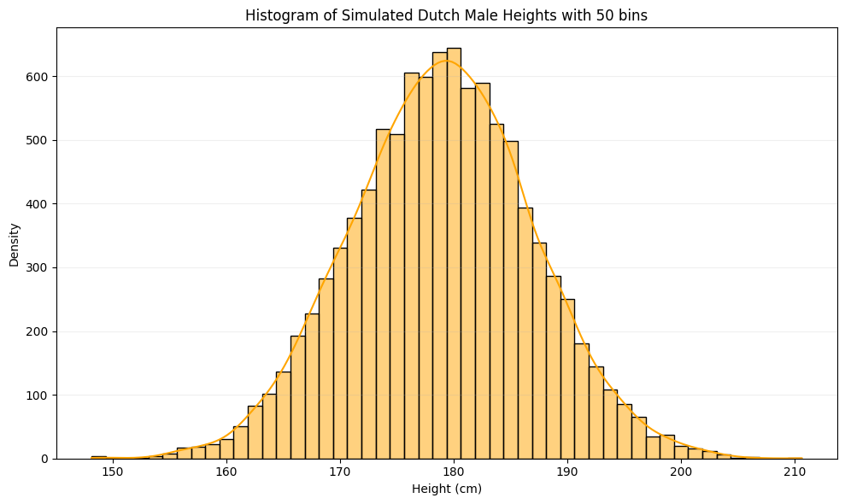
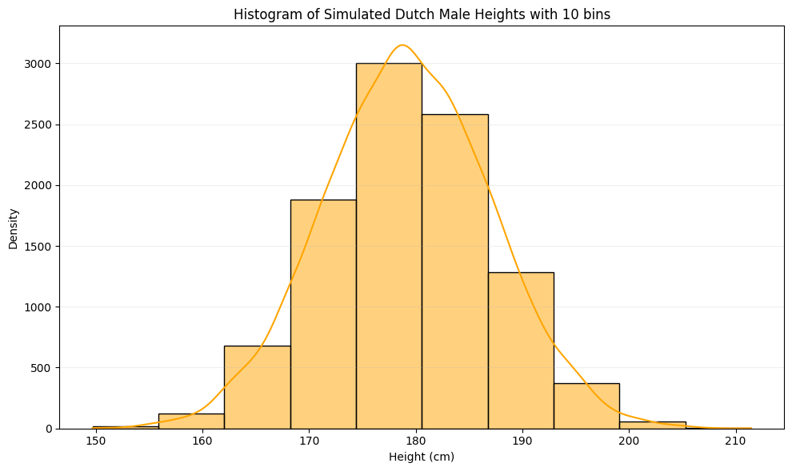
Visualizing numerical data
How to visualize distributions of numerical variables:
Histogram
Boxplot
Violinplot
Stripchart
…

Slide 23
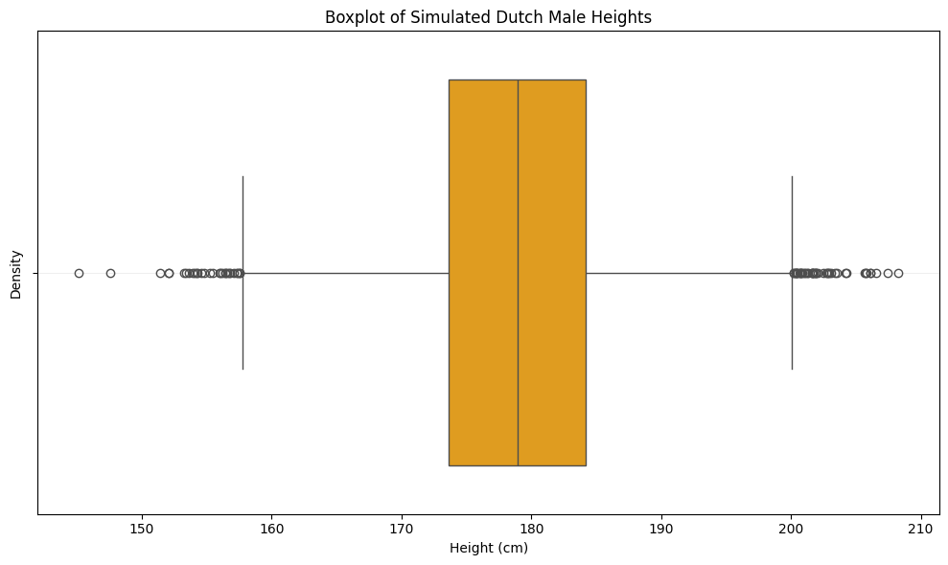
Visualizing numerical data
Median aka 50th percentile
How to visualize distributions:
Histogram
Boxplot
Violinplot
Stripchart
…
3rd quartile aka 75th percentile
Outliers
Median - 1.5 * IQR
1st quartile aka 25th percentile
Median + 1.5 * IQR

Slide 24
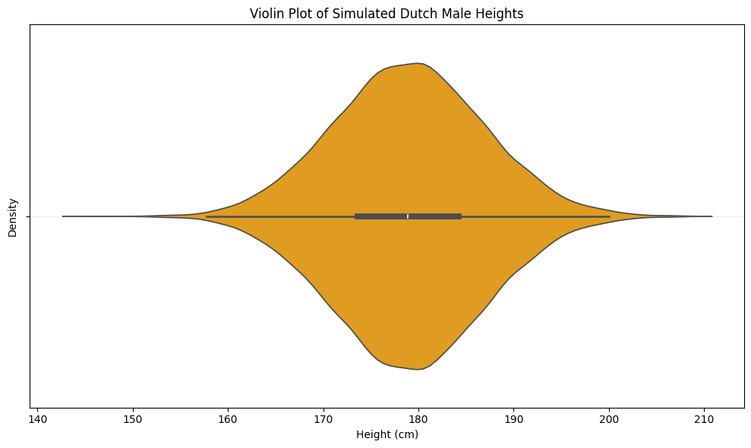
Visualizing numerical data
How to visualize distributions:
Histogram
Boxplot
Violinplot
Stripchart
…

Slide 25
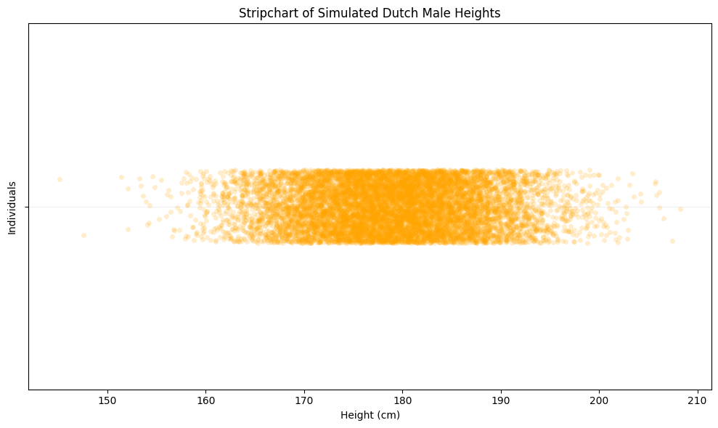
Visualizing numerical data
How to visualize distributions:
Histogram
Boxplot
Violinplot
Stripchart
…

Slide 26
Visualizing numerical data
Which one do you like the most?

Slide 27
Visualizing numerical data
Again, it depends on what you want to highlight!

Slide 28
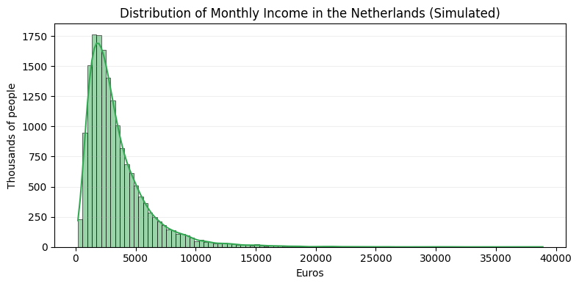
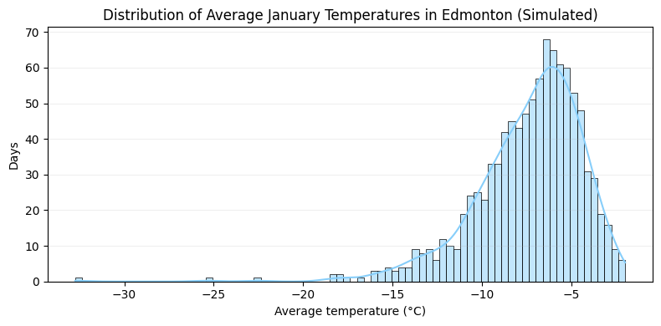
Plotting the sample distribution
Skewed data is data where there is a lack of symmetry in the distribution of the data:
We also say a thick-tailed or long-tail distribution since there is more data in the tail (outer edge) of the distribution.
Long right tail
Long left tail

Slide 29
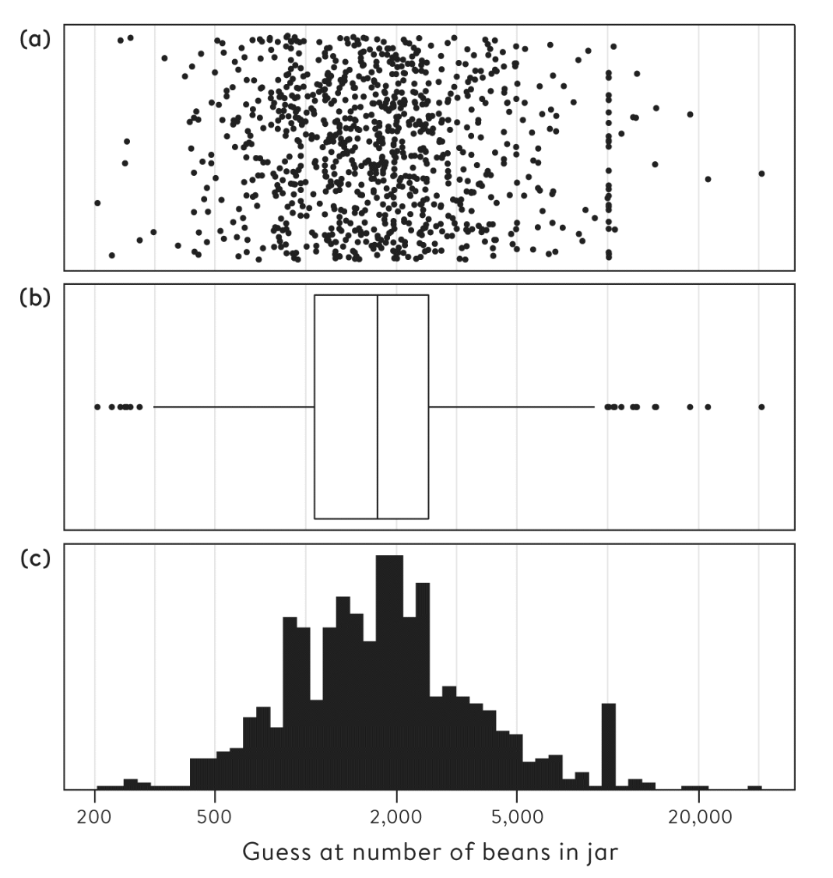
Plotting the sample distribution, log(x) axis
Strip chart
Box and whisker plot
Histogram
Notes:
What do you think it is?

Slide 30
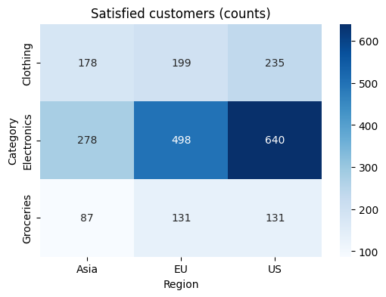
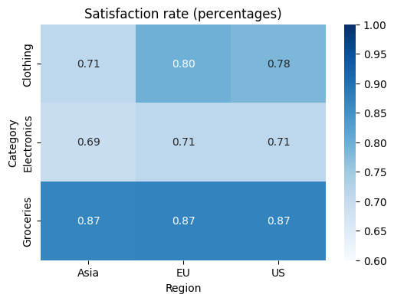
Visualizing Categorical Data: Tables and Heatmaps
There are multiple aspects to consider:
Positive vs negative framing: the chosen framing affects how patterns are perceived.
Counts vs percentages: absolute scale or relative values?
Bias in the counts from unmeasured reasons: for example, data imbalance
Assume we track customer satisfaction (yes/no) of the store per department: clothing, electronics and groceries
How can this be possible?
Notes:
A classic example of how alternative framing can change the emotional impact of a number is an advertisement that appeared on the London Underground in 2011, proclaiming that ‘99% of young Londoners do not commit serious youth violence’. These ads were presumably intended to reassure passengers about their city, but we could reverse its emotional impact with two simple changes. First, the statement means that 1% of young Londoners do commit serious violence. Second, since the population of London is around 9 million, there are around 1 million people aged between 15 and 25, and if we consider these as ‘young’, this means there are 1% of 1 million or a total of 10,000 seriously violent young people in the city. This does not sound at all reassuring. Note the two tricks used to manipulate the impact of this statistic: convert from a positive to a negative frame, and then turn a percentage into actual numbers of people.
Bias: perhaps some hospitals get more sick individuals making their counts higher, maybe they’re in a poorer region, etc.

Slide 31
Visualizing Categorical Data: Tables and Heatmaps
There are multiple aspects to consider:
Positive vs negative framing: the chosen framing affects how patterns are perceived.
Counts vs percentages: absolute scale or relative values?
Bias in the counts from unmeasured reasons: for example, data imbalance
Assume we track customer satisfaction (yes/no) of the store per department: clothing, electronics and groceries
How can this be possible?
"Electronics": {
"US": 900,
"EU": 700,
"Asia": 400
},
"Clothing": {
"US": 300,
"EU": 250,
"Asia": 250
},
"Groceries": {
"US": 150,
"EU": 150,
"Asia": 100
}
}
Notes:
A classic example of how alternative framing can change the emotional impact of a number is an advertisement that appeared on the London Underground in 2011, proclaiming that ‘99% of young Londoners do not commit serious youth violence’. These ads were presumably intended to reassure passengers about their city, but we could reverse its emotional impact with two simple changes. First, the statement means that 1% of young Londoners do commit serious violence. Second, since the population of London is around 9 million, there are around 1 million people aged between 15 and 25, and if we consider these as ‘young’, this means there are 1% of 1 million or a total of 10,000 seriously violent young people in the city. This does not sound at all reassuring. Note the two tricks used to manipulate the impact of this statistic: convert from a positive to a negative frame, and then turn a percentage into actual numbers of people.
Bias: perhaps some hospitals get more sick individuals making their counts higher, maybe they’re in a poorer region, etc.

Slide 32
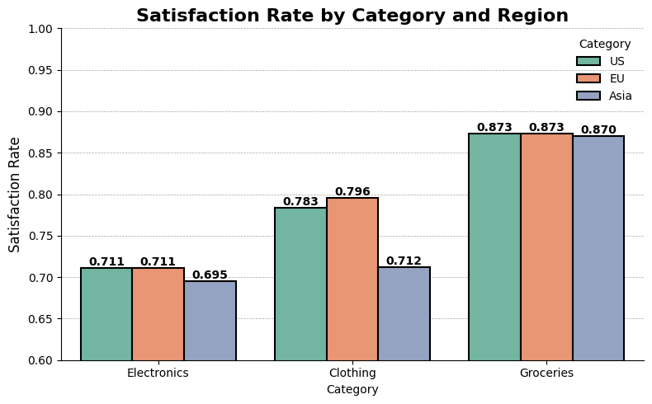
Visualizing Categorical Data: Bar Plots
Bar plots: bar per category or per combination of categories
Same information
Notes:
Reading the bar plot. What is it showing us?
Might we want to see this also as counts?

Slide 33
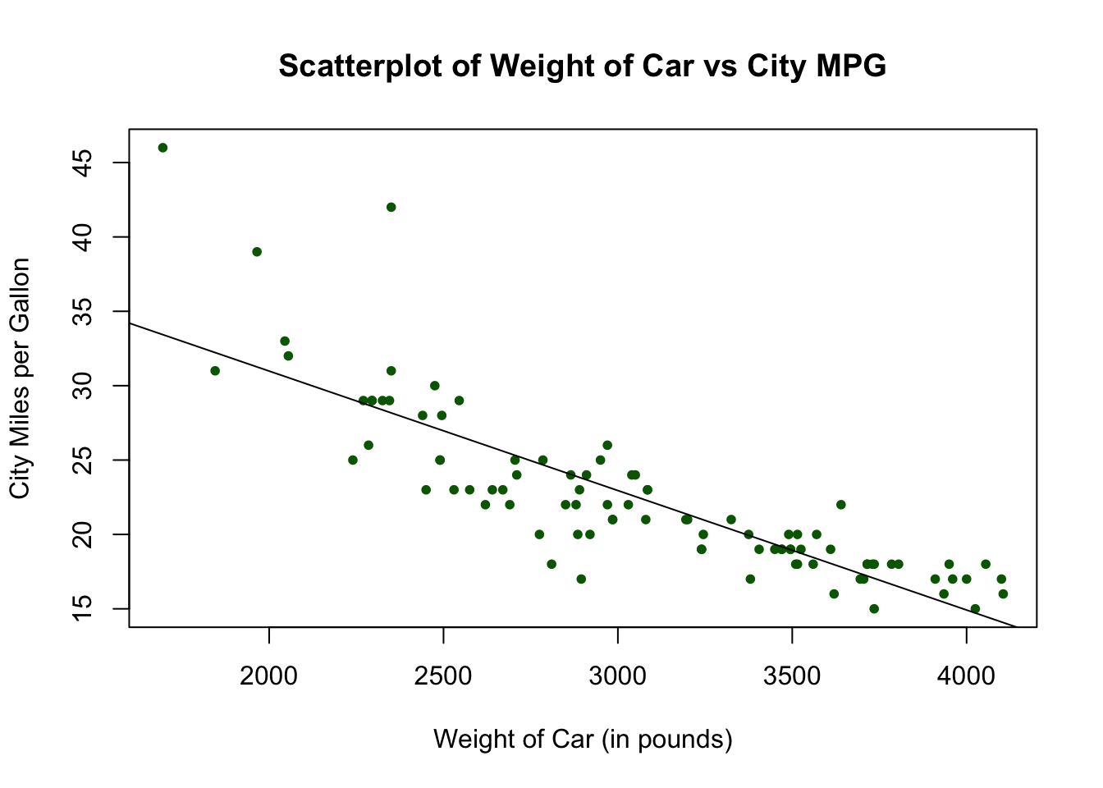
Visualize relationships between variables
Scatter plots can help visualizing pair-wise relationships between numerical variables:
You can even fit a regression line to demonstrate trends
https://bookdown.org/dli/rguide/scatterplots-and-best-fit-lines-single-set.html

Slide 34
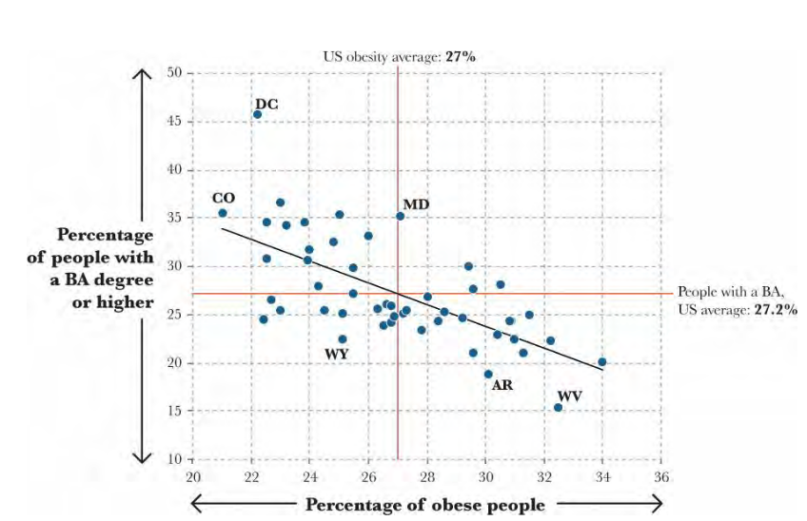
Scatter plots visualize relationships between variables
The Functional Art, Alberto Cairo
Notes:
Great at showing relationships between variables.

Slide 35
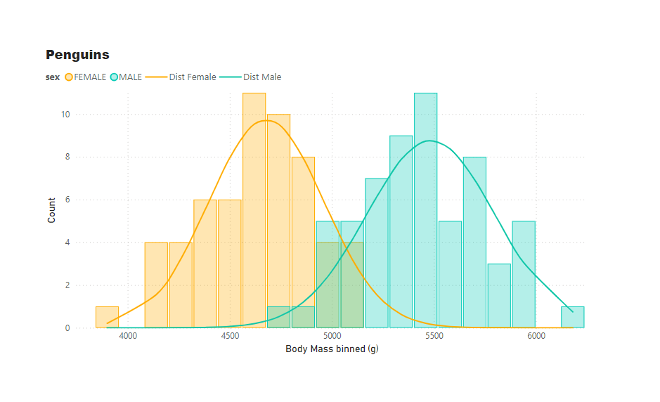
Visualize relationships between variables
Overlapping and color-coded histograms to show relationship between numerical and categorical values.
https://kerrykolosko.com/overlapping-histogram-with-distribution-curve/

Slide 36
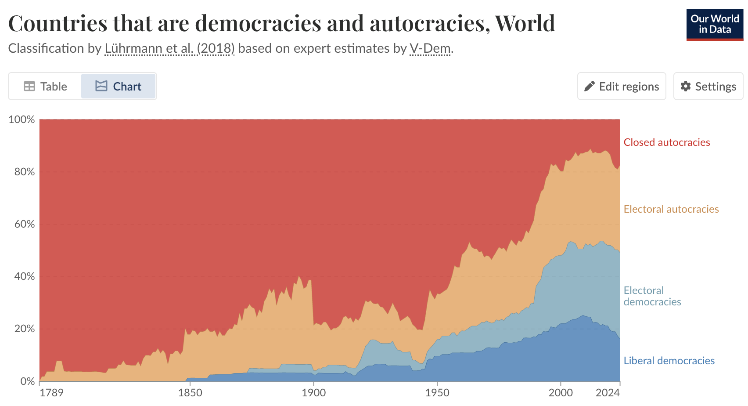
Visualize relationships between variables
Stacked area chart can help to demonstrate trends:
2 numerical variables: year and proportion
1 categorical variable: type of political regime
Unrolling many pie-charts for each time slice
Notes:
1. Highlight part-to-whole contribution
2. Show radical changes to contribution over time:
3. Give a rough idea of the numbers, not exact values:

Slide 37
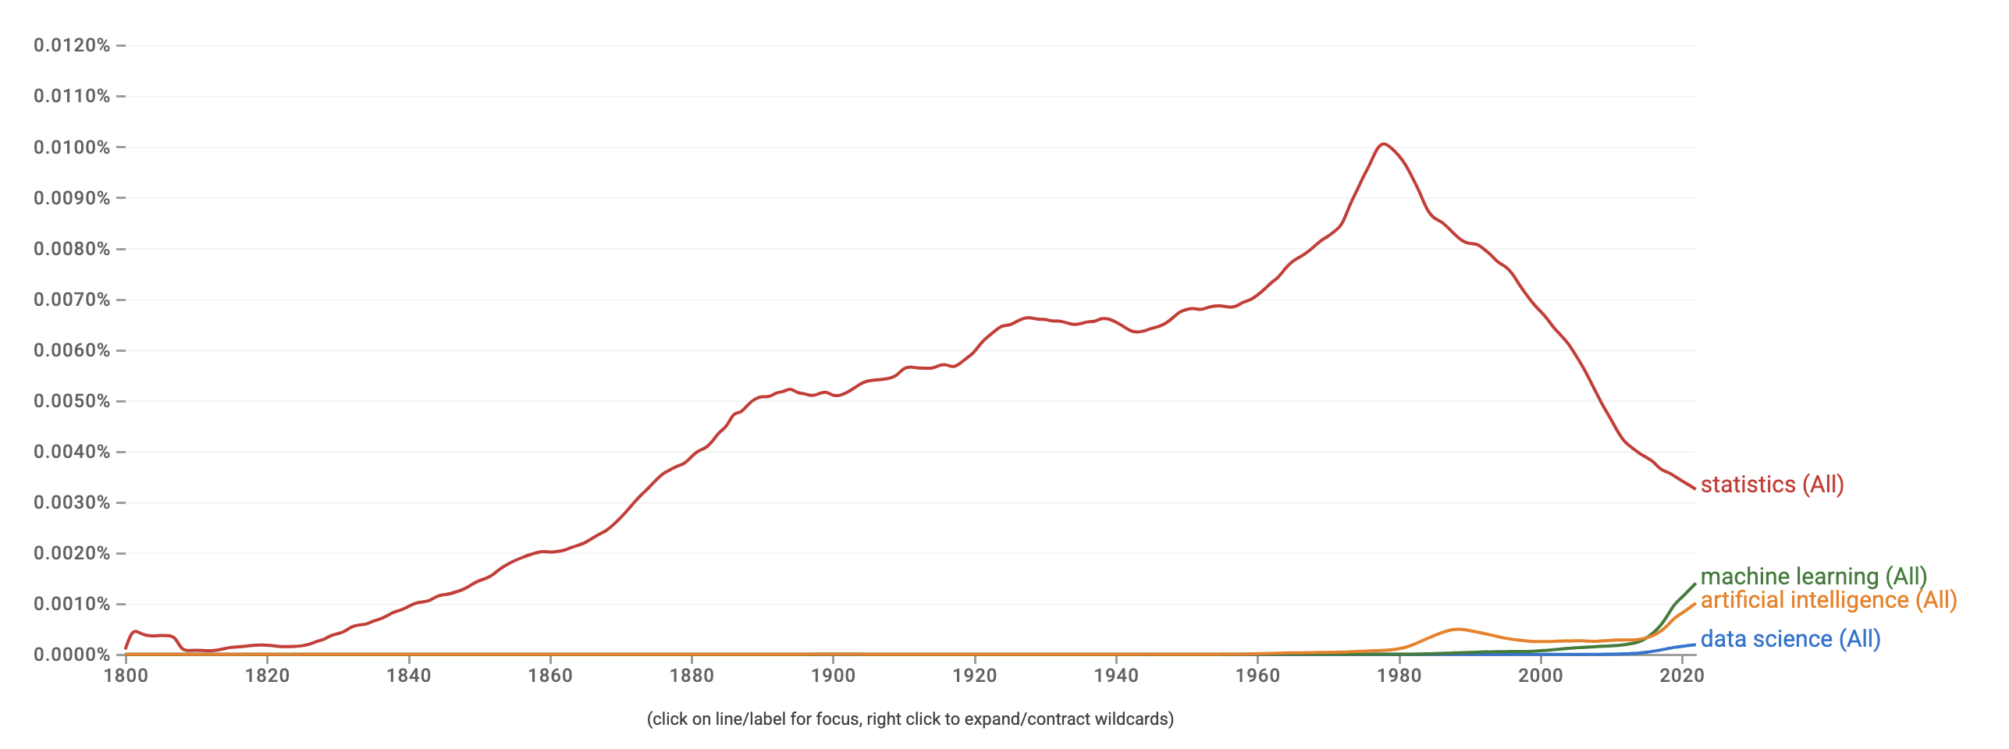
Or just a line graph…
Notes:
Y-axis is n-gram appearances

Slide 38
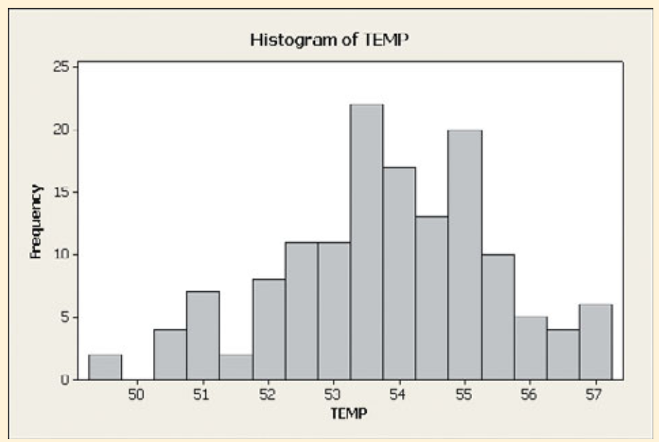
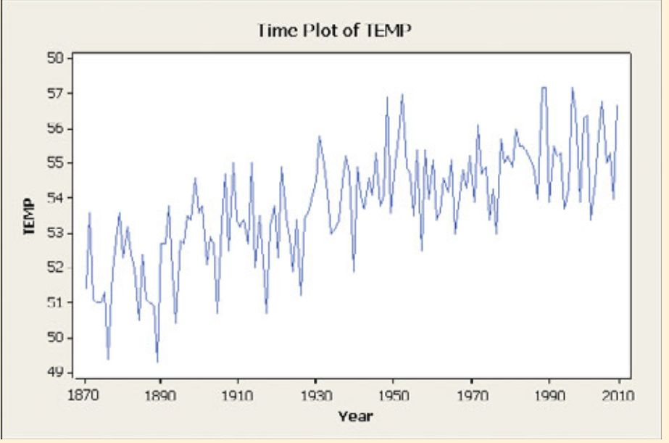
Line graph vs Histogram
Notes:
Central park in new York temperatures.

Slide 39
Overlapping Histograms
https://kerrykolosko.com/overlapping-histogram-with-distribution-curve/

Slide 40
What makes an effective visualization?
Have graphical integrity (frame accurately)
Keep it simple (no extraneous information)
Use the right display (choose the right plot)
Use color strategically (to draw attention/give information)
Tell a story with data that is easy to intuit
Notes:
Go over the slides from EDA lecture by Blintzen. Can it be made more interactive?

Slide 41
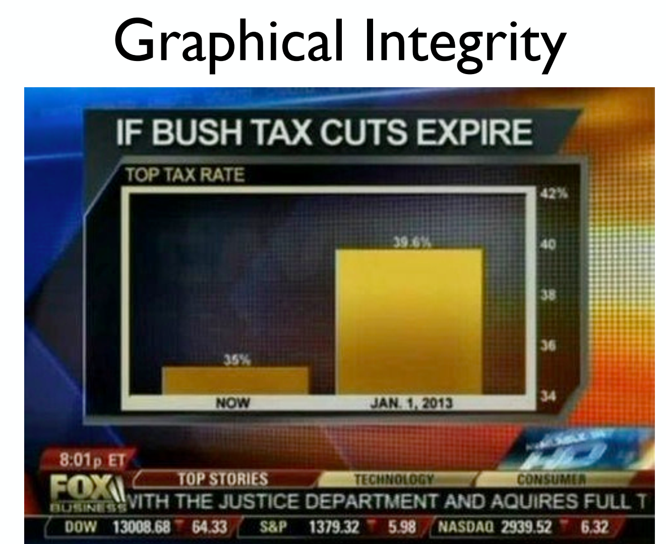

Slide 42
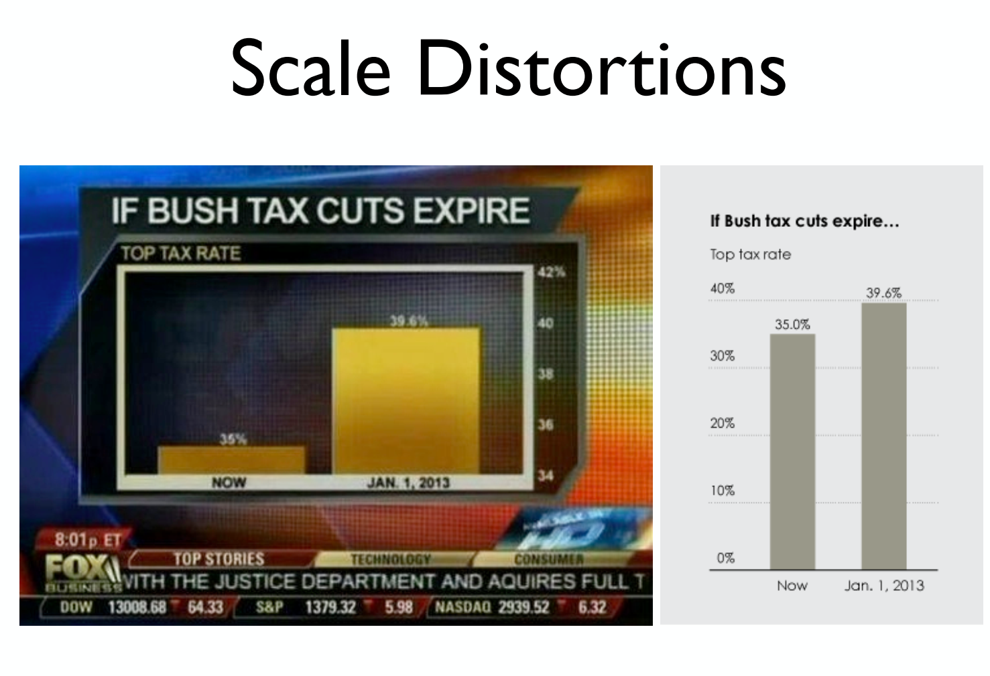

Slide 43
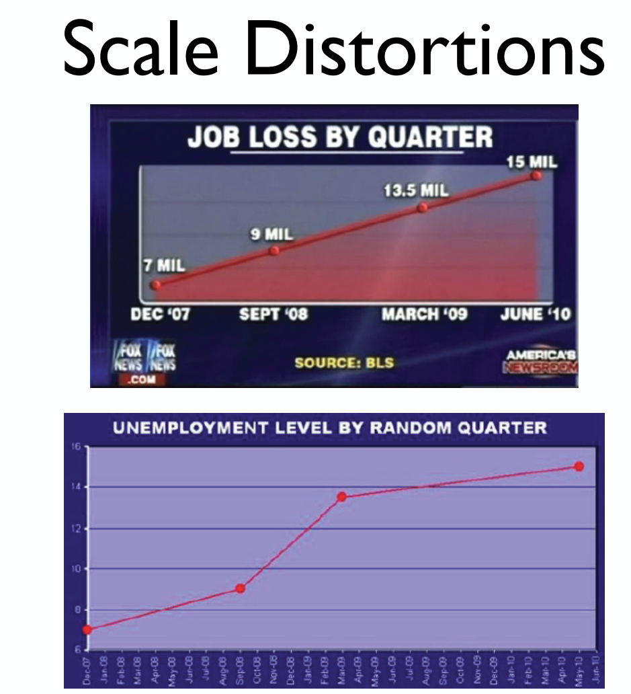

Slide 44
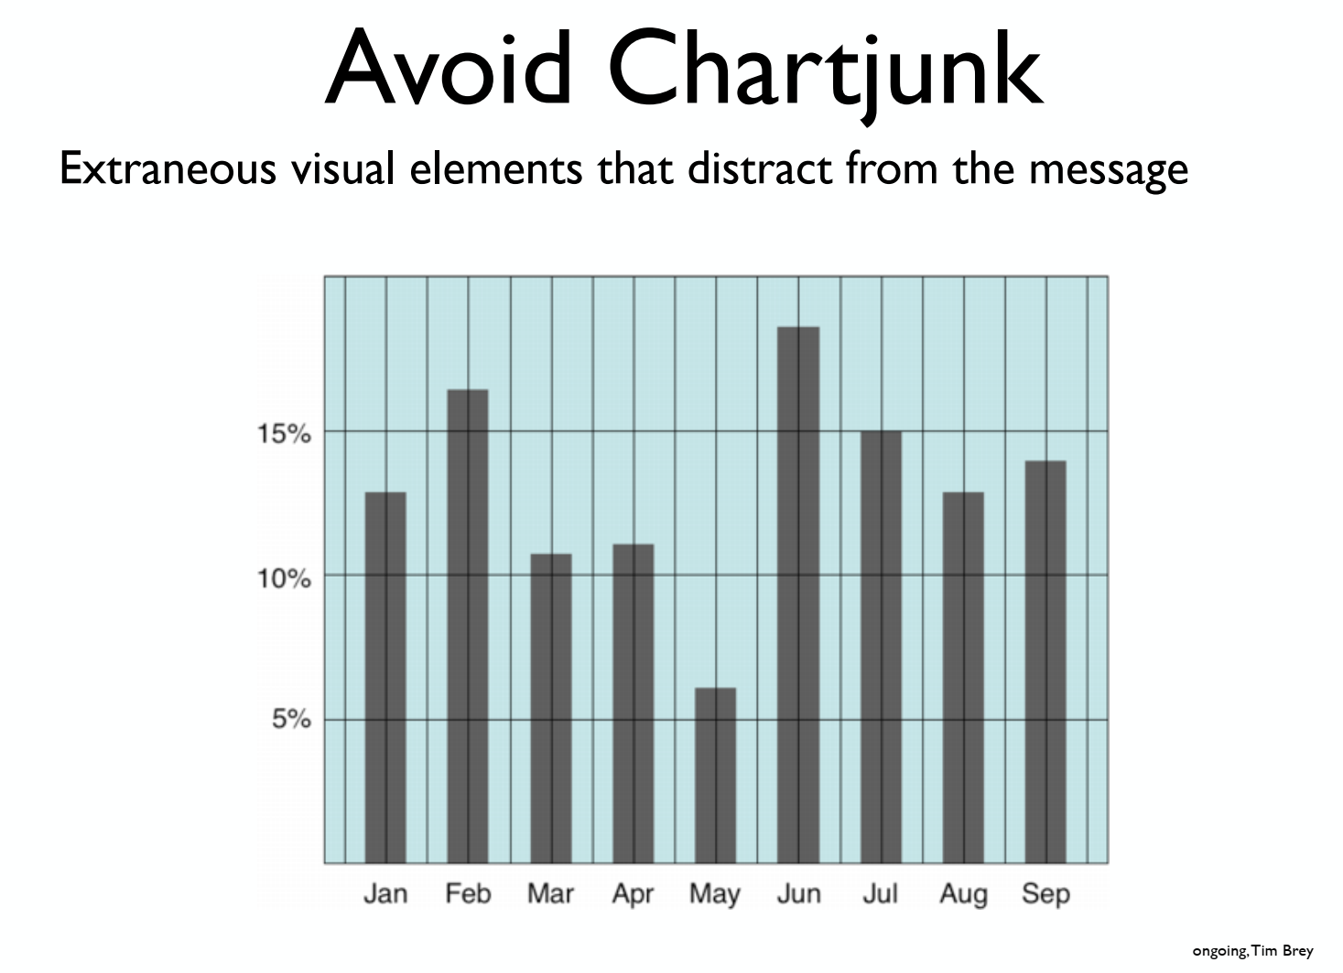

Slide 45
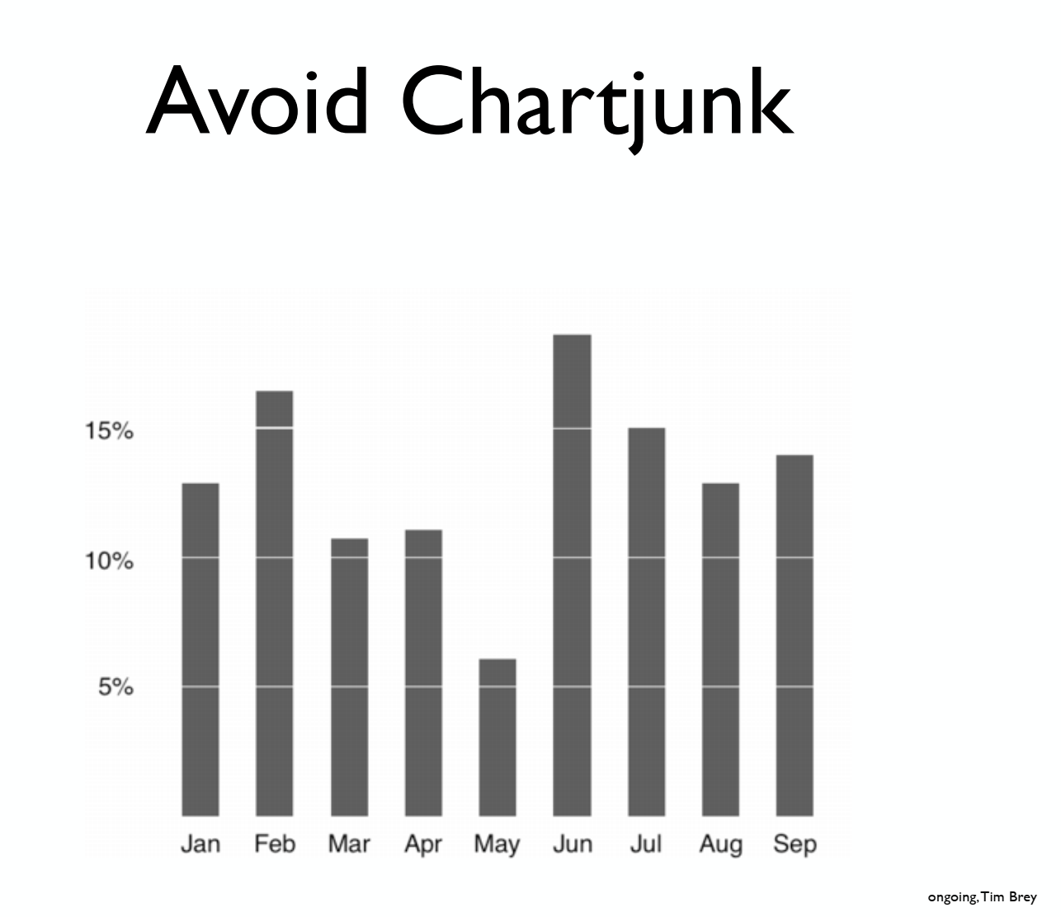

Slide 46
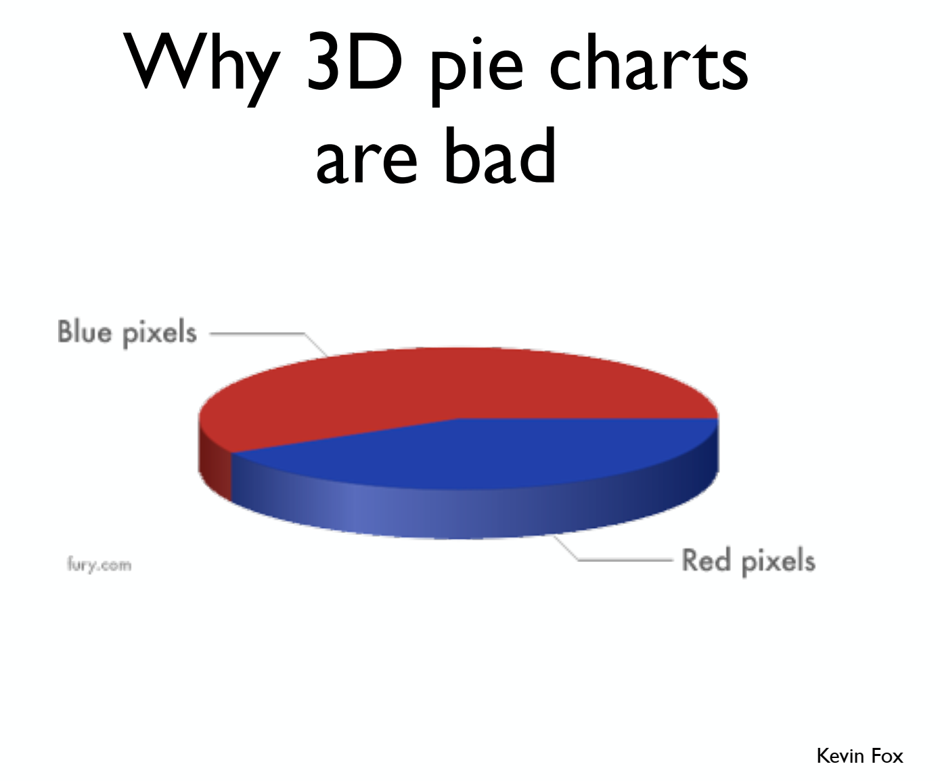

Slide 47
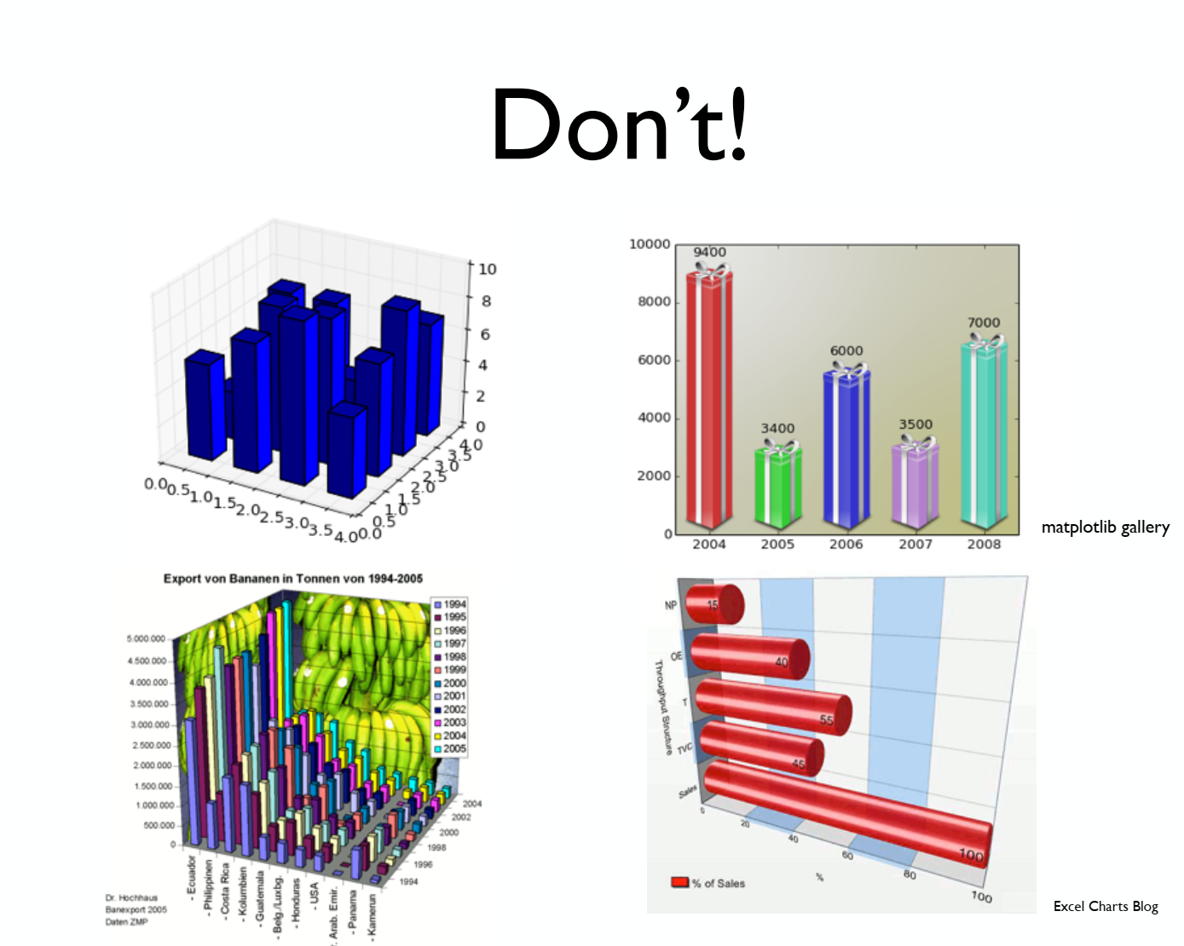

Slide 48
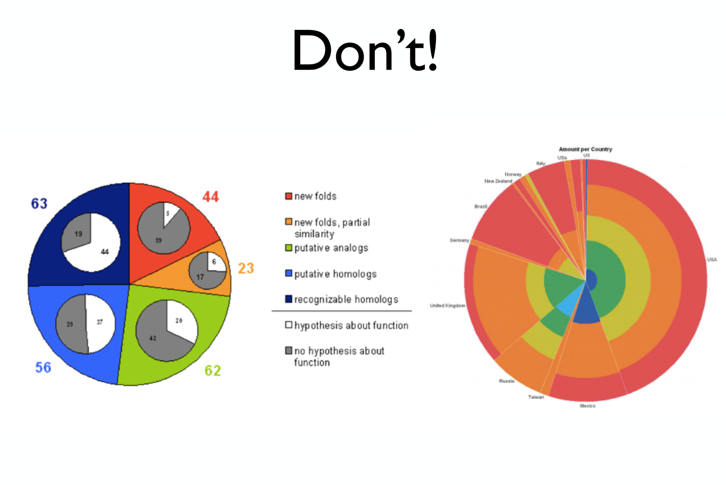

Slide 49
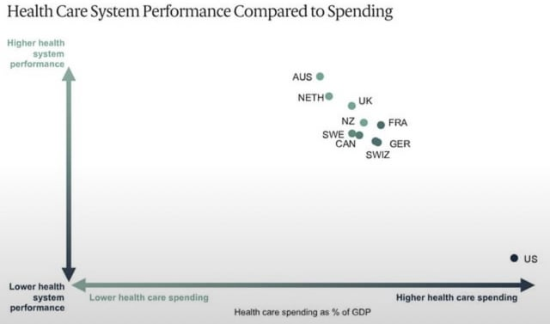
What is wrong with this plot?
Notes:
Whats with the overly extended axis? What aren’t we seeing here? Why isn’t the axis more sensible?
Where are the numbers?

Slide 50
Some data is hard to visualize
What if we had 100s of variables?
What if some of the data was categorical?
Can be useful if when you have multiple dimensions you can still look at them in pairs in scatterplots/boxplots/histograms.

Slide 51
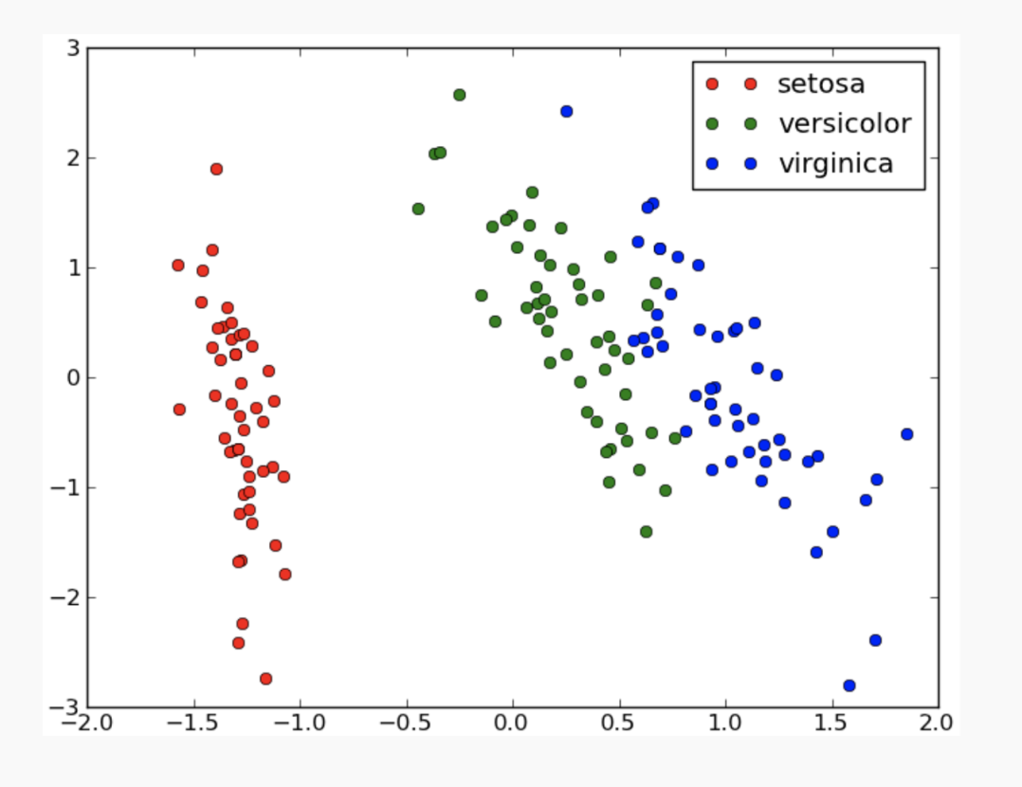
Color Coding can be useful
Notes:
X and y: petal length and sepal length, mean removed

Slide 52
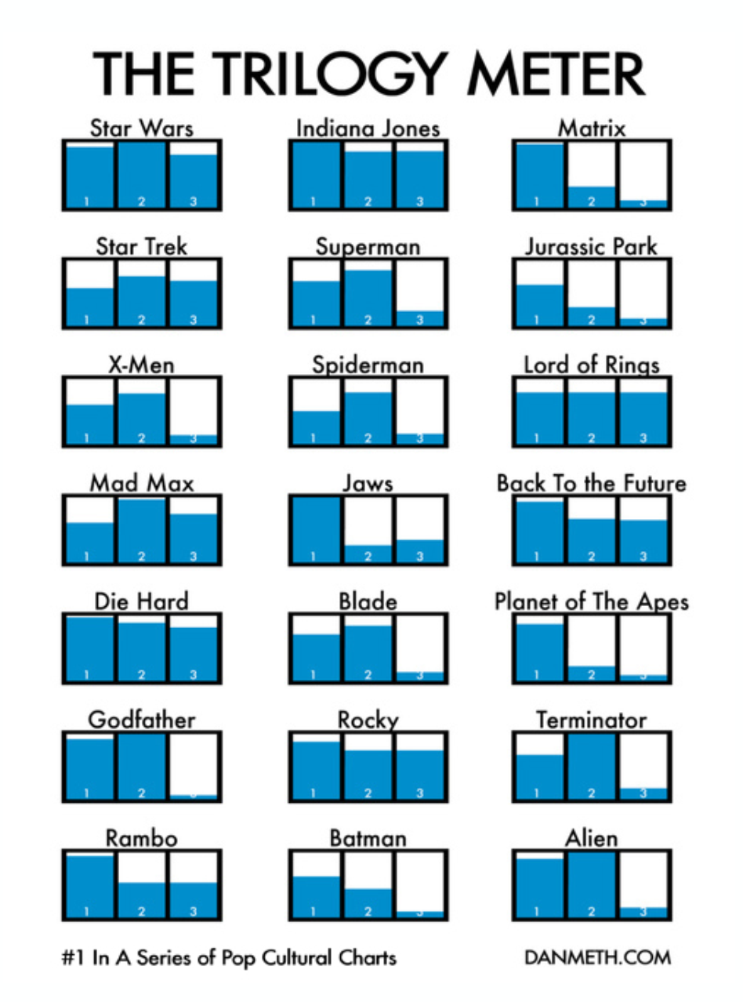
Try Small Multiples
Perhaps you have different opinions…
Or perhaps you’ve seen none of these movies.

Slide 53
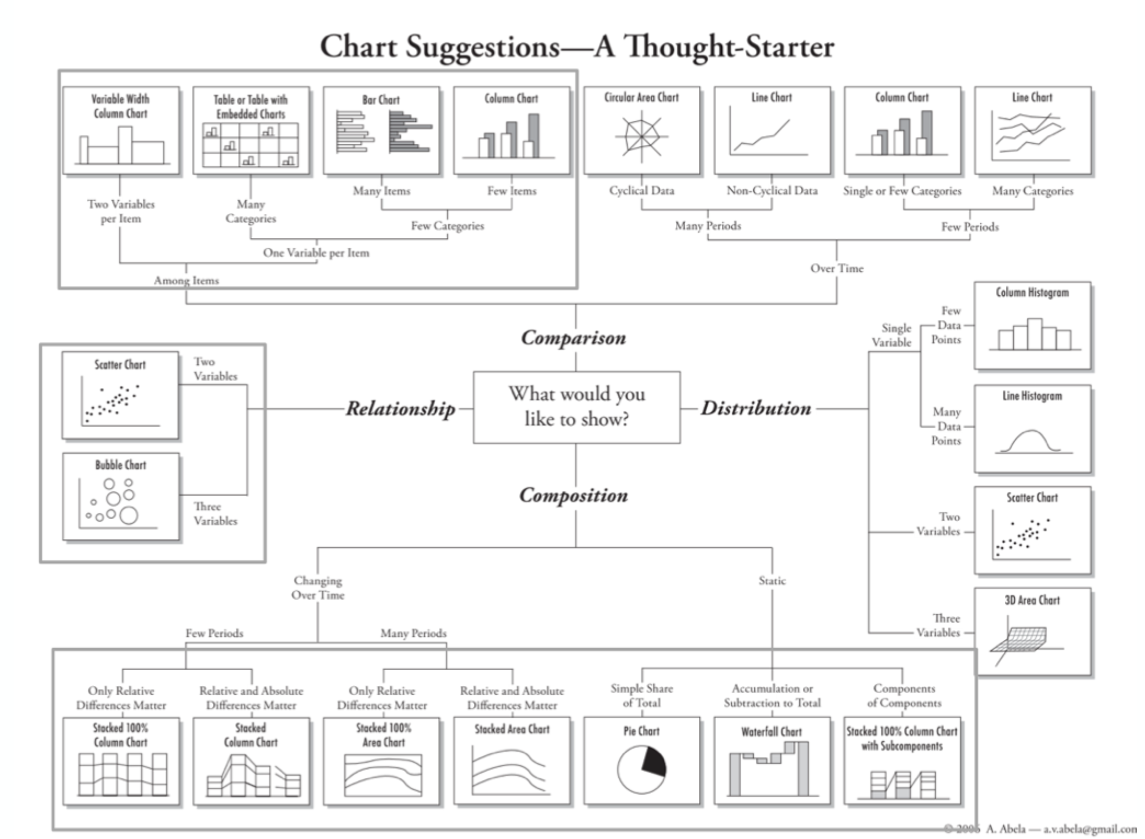

Slide 54
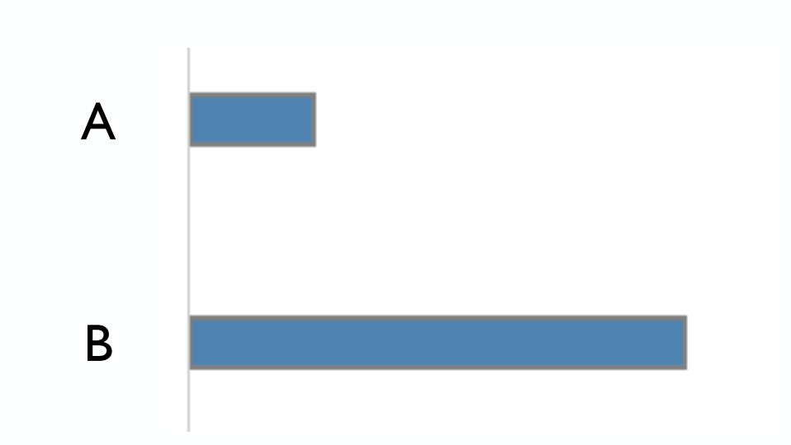
Notes on Perceptual Effectiveness: How much longer is B?
4x

Slide 55
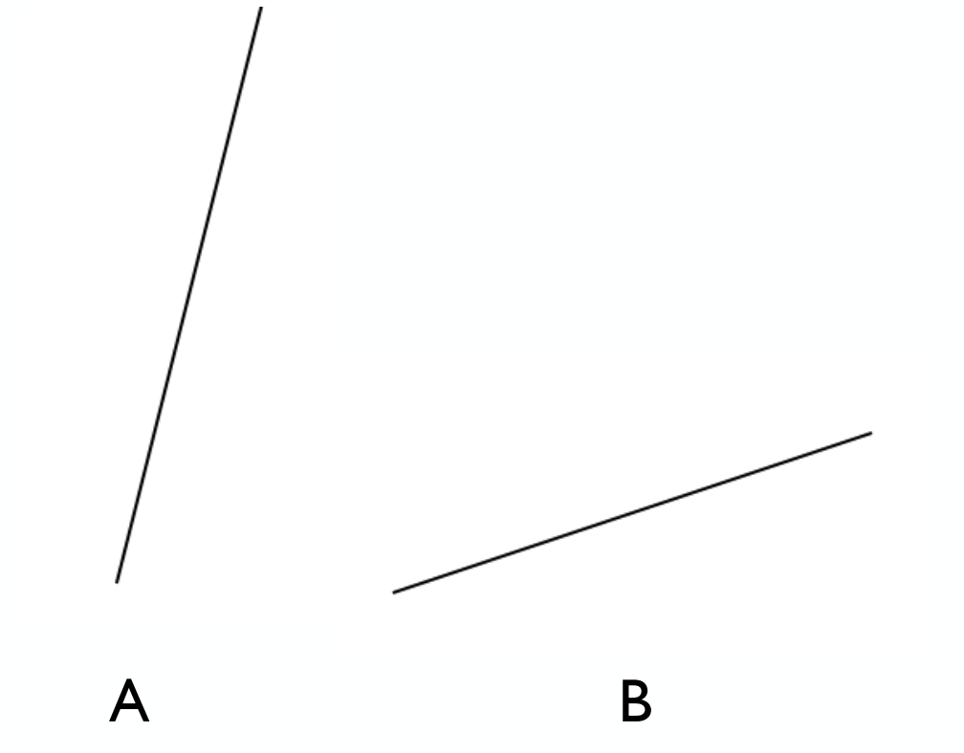
Notes on Perceptual Effectiveness: How much steeper is A?
4x

Slide 56
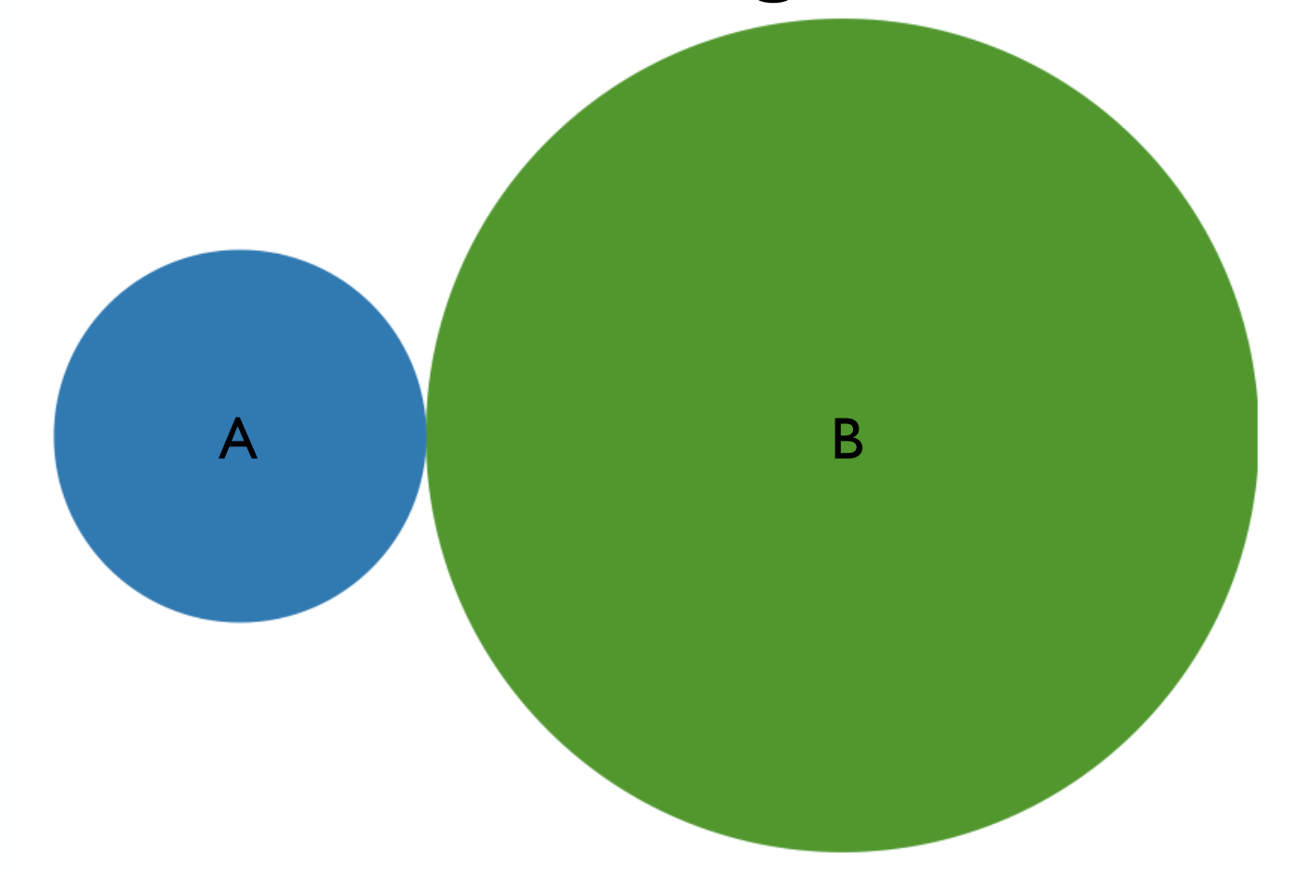
Notes on Perceptual Effectiveness: How much bigger in area is B?
10x

Slide 57
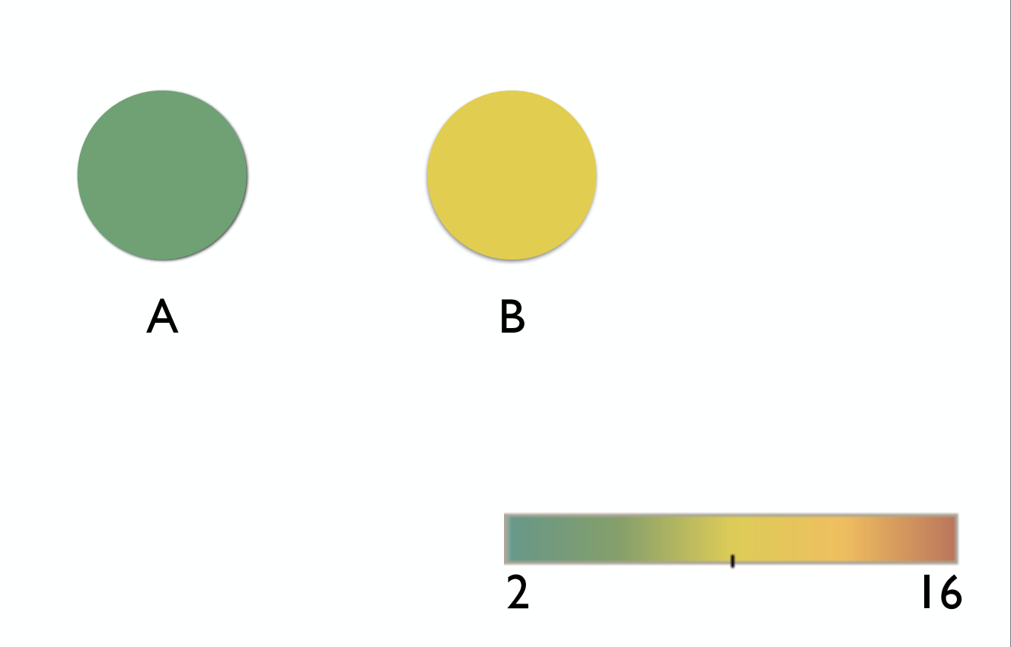
Notes on Perceptual Effectiveness: How much bigger is B?
4x

Slide 58
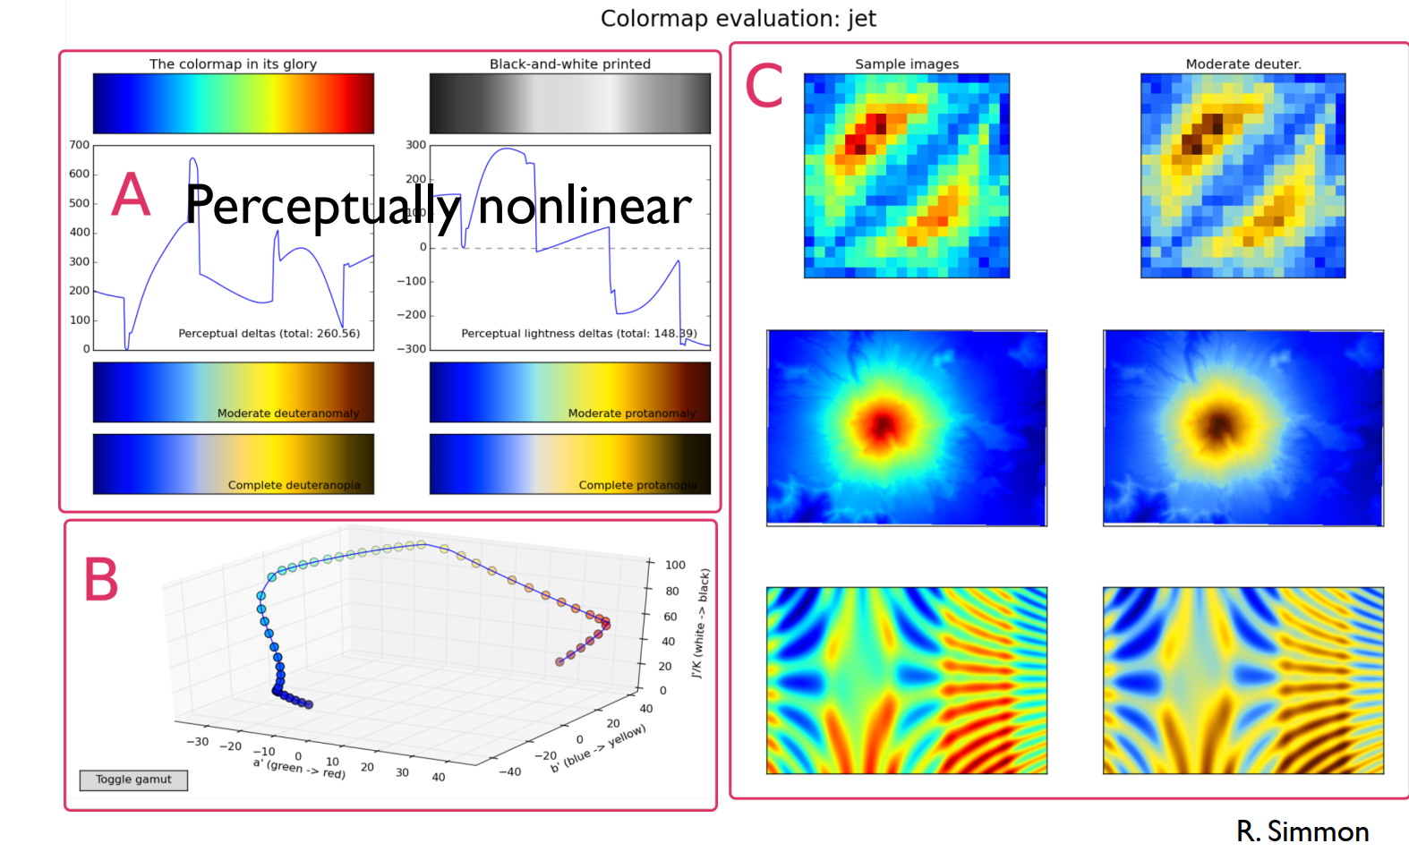
Avoid Rainbow Colormaps!
Use Color Brewer to find good color schemas.

Slide 59

Perceptual Effectiveness
Most accurate comparisons possible.
Larger pattern detection possible.

Slide 60

Perceptual Effectiveness

Slide 61


Assessing Sales: Which plot?

Slide 62


Assessing Market Share: Which plot?

Slide 63


Assessing Energy: Which plot?

Slide 64


Assessing a sports team performance: Which plot?

Slide 65


Assessing furniture sales across regions

Slide 66

There are many types of plots…
Check here one of the Python libraries for plotting: https://seaborn.pydata.org/examples/index.html
Notes:
Go over the slides from EDA lecture by Blintzen. Can it be made more interactive?

Slide 67
Describing data quantitatively
In some cases, we need much simpler data summary than sophisticated data visualization strategies:
Deliver a structured report to a company management (that does not know about box plots)
Compare the differences between two samples with hundreds of variables
…

Slide 68
Describing data quantitatively
In some cases, we need much simpler data summary than sophisticated data visualization strategies:
Deliver a structured report to a company management (that does not know about box plots)
Compare the differences between two samples with hundreds of variables
…
Common statistics:
Measures of central tendency: mean, median, mode
Measures of spread: variance, standard deviation, percentiles, IQR
Others: skewness, kurtosis

Slide 69


Measures of central tendency
Population mean:
High-school bench press distribution (kg):
60 | 61 | 62 | 63 | 64 | 65 | 66 | 67 | 68 | 69 | 70 | 71 | 72 | 73 | 74 | 75 | 76 | 77 | 78 | 79 | 80 | 81 | 82 | 83 | 84 | 85 | 86 | 87 | … | … | … | 118 | 119 | 120 | 121 | 122
Mean/Average of the population:
$$\frac{(60 + 62 + 64 + 65 + 68 + 72 + 73 + 75 + 78 + 79 + 81 + 83 + 93 + 94 + 95)}{15} = 81.53$$

Slide 70

Measures of central tendency
Population mean:
High-school bench press distribution (kg):
60 | 61 | 62 | 63 | 64 | 65 | 66 | 67 | 68 | 69 | 70 | 71 | 72 | 73 | 74 | 75 | 76 | 77 | 78 | 79 | 80 | 81 | 82 | 83 | 84 | 85 | 86 | 87 | … | … | … | 118 | 119 | 120 | 121 | 122
Mean/Average of the population:
$$\frac{(60 + 62 + 64 + 65 + 68 + 72 + 73 + 75 + 78 + 79 + 81 + 83 + 120 + 121 + 122)}{15} = 81.53$$

Slide 71


Measures of central tendency
Sample mean:
A sample from the high-school bench press distribution (kg):
60 | 61 | 62 | 63 | 64 | 65 | 66 | 67 | 68 | 69 | 70 | 71 | 72 | 73 | 74 | 75 | 76 | 77 | 78 | 79 | 80 | 81 | 82 | 83 | 84 | 85 | 86 | 87 | … | … | … | 118 | 119 | 120 | 121 | 122
Mean/Average of the population:
$$\frac{(60 + 72 + 75 + 83)}{5} = 72.5$$

Slide 72

Measures of central tendency
Sample mean:
A sample from the high-school bench press distribution (kg):
60 | 61 | 62 | 63 | 64 | 65 | 66 | 67 | 68 | 69 | 70 | 71 | 72 | 73 | 74 | 75 | 76 | 77 | 78 | 79 | 80 | 81 | 82 | 83 | 84 | 85 | 86 | 87 | … | … | … | 118 | 119 | 120 | 121 | 122
Mean/Average of the sample:
$$\frac{(62 + 72 + 75 + 83 + 122)}{5} = 82.4$$

Slide 73


Measures of central tendency
Median: sort all values and pick the one which splits data into two equal parts.
Odd n:
What do you think about mean and median?
Even n:
High-school bench press distribution (kg):
60 | 61 | 62 | 63 | 64 | 65 | 66 | 67 | 68 | 69 | 70 | 71 | 72 | 73 | 74 | 75 | 76 | 77 | 78 | 79 | 80 | 81 | 82 | 83 | 84 | 85 | 86 | 87 | … | … | … | 118 | 119 | 120 | 121 | 122

Slide 74

Measures of central tendency
Long right tail
Symmetric
Long left tail
*Mode: the most frequent value in a sample/population

Slide 75

Mean and Median: Bimodal Distributions
Always look at your data!
Distribution of the Surface Area of the Earth.

Slide 76

Measures of spread
Why is it not enough to use measures of central tendency?
Imagine that you test different recommendation algorithms for an app:
As a business you want to increase the length of the average user session in the app (to show more adds)
You have 2 algorithms to suggest videos (reels): automated and user-driven
That’s actually a new Instagram update:

Slide 77

Measures of spread
Why is it not enough to use measures of central tendency?
Imagine that you test different recommendation algorithms for an app:
As a business you want to increase the length of the average user session in the app (to show more adds)
You have 2 algorithms to suggest videos (reels): automated and user-driven
You compute the mean session length: 30.1 vs 30.01
What do we see?

Slide 78

Measures of spread
Population variance:
Standard deviation (std)
How far are measurements from population mean
Population: [5, 7, 9, 11, 13, 15, 22, 42, 45]
Compute variance and std:

Slide 79


Measures of spread
Sample variance:
Sample standard deviation (std)
We divide by $n−1$to correct for bias introduced by estimating the mean from the same data.
How far are measurements from sample mean
Sample: [5, 7, 9, 11, 13, 15, 22, 42, 45]
Compute sample variance and std:

Slide 80

Measures of spread
Percentiles:
1st, 3rd quartiles (q1, q3) aka 25% and 75% percentiles
IQR = q3 – q1
p% percentiles
Imagine that you test different recommendation algorithms for an app:
As a business you want to make sure that the algorithms fit certain latency constraints
Assume, we want our model to recommend the next video under than 100ms in most cases
We can compute 99th percentile (p99), assuming that 1% of times there are some issues not related to the algorithm

Slide 81

Measures of spread
Data Scientist Salaries
Notes:
How can we assess how good the median is as a prediction of the salary here?

Slide 82


Other statistical measures
Skewness:
What if mean and std are the same, but distributions still differ, can we describe it quantitively?
Skewness right-tail: 0.89
Skewness left-tail: -0.95

Slide 83
Summary
Data visualization
Useful resource: The Functional Art by Alberto Cairo
Distributions and skewed data
Summarizing data
Checking how good is our summary

